Slide 1
Government Dataset Analysis
Analysis of Consumer Price Index (CPI)
Prepared by: Y. Bhavana

Slide 2
INTRODUCTION
This dataset contains the All India Consumer Price Index (CPI) data as of February 2019. It provides monthly price index values for various categories of goods and services across different sectors (Rural, Urban, and Combined).
This presentation provides an analysis of the Consumer Price Index (CPI) dataset, which includes data on food, housing, clothing, transport, health, and general inflation across different sectors (Rural, Urban, and Combined).

Slide 3
Dataset Overview
This dataset has 222 rows and 30 columns
The dataset contains Consumer Price Index (CPI) values from various years and months.
It includes different sectors: Rural, Urban, and Combined.
Categories include Food, Housing, Clothing, Transport, Health, and more.

Slide 4
Data Cleaning: Handling Missing Values
Some columns have missing values, especially 'Housing'.
Strategies to handle missing data:
Remove rows with missing values (if minimal impact).
Fill missing values with the mean, median, or mode.
Missing Values Summary:
Housing has 74 missing values.

Slide 5
Column Descriptions:
1. Sector: Type of region (Rural, Urban, or Rural+Urban).
2. Year: The year of data recording.
3. Month: The month of data recording.
4. Cereals and products: Index for cereal-based food items.
5. Meat and fish: Index for meat and fish products.
6. Egg: Index for eggs.
7. Milk and products: Index for milk and dairy products.
8. Oils and fats: Index for edible oils and fats.
9. Fruits: Index for various fruits.
10. Vegetables: Index for various vegetables.
11. Pulses and products: Index for pulses (lentils, beans, etc.).
12. Sugar and Confectionery: Index for sugar and related products.
13. Spices: Index for commonly used spices.
14. Non-alcoholic beverages: Index for soft drinks, tea, coffee, etc.
15. Prepared meals, snacks, sweets etc.: Index for packaged and prepared food items.

Slide 6
Column Descriptions:
16. Food and beverages: Combined index for all food and beverage categories.
17. Pan, tobacco and intoxicants: Index for tobacco, betel leaves, and similar products.
18. Clothing: Index for clothing items.
19. Footwear: Index for footwear.
20. Clothing and footwear: Combined index for clothing and footwear.
21. Housing: Index for housing-related expenses (only available for Urban & Rural+Urban sectors).
22. Fuel and light: Index for fuel (LPG, electricity, kerosene, etc.).
23. Household goods and services: Index for furniture, appliances, and home services.
24. Health: Index for medical expenses.
25. Transport and communication: Index for public and private transportation, and communication services.
26. Recreation and amusement: Index for entertainment expenses.
27. Education: Index for education-related expenses.
28. Personal care and effects: Index for personal care products (cosmetics, hygiene products, etc.).
29. Miscellaneous: Index for other categories not explicitly mentioned.
30. General index: Overall price index covering all categories.

Slide 7
Data Cleaning: Removing Duplicates
Duplicate records can affect analysis accuracy.
Checking for duplicates: Found 0 duplicate rows.
Solution: Remove duplicate entries to ensure unique data points.

Slide 8
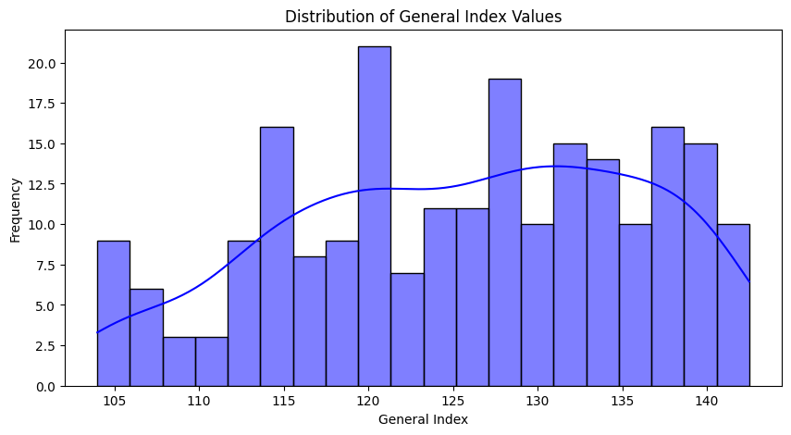
Data Visualizations
Distribution of General Index Values

Slide 9
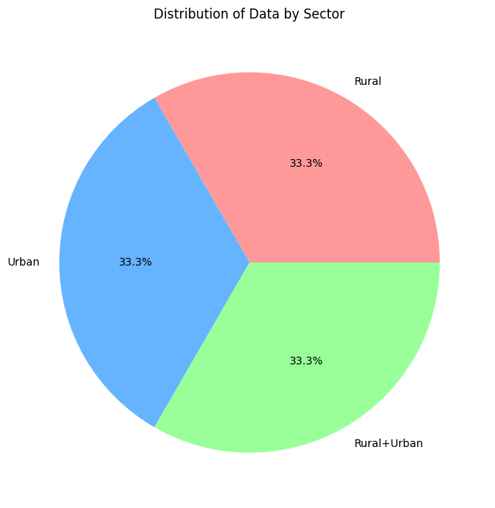
Distribution of Data by Sector

Slide 10
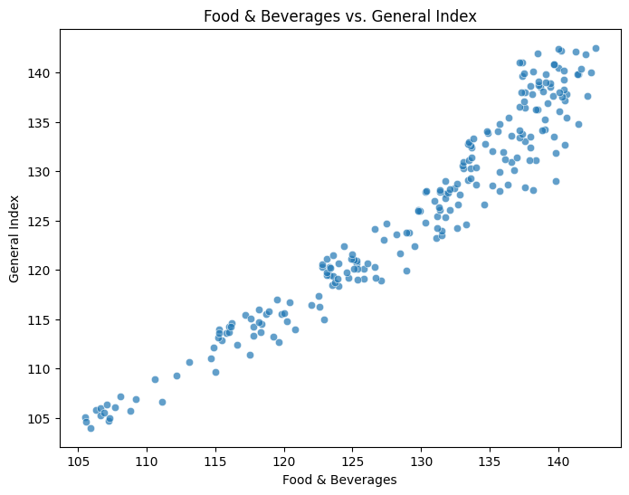
Food & Beverages vs. General Index

Slide 11
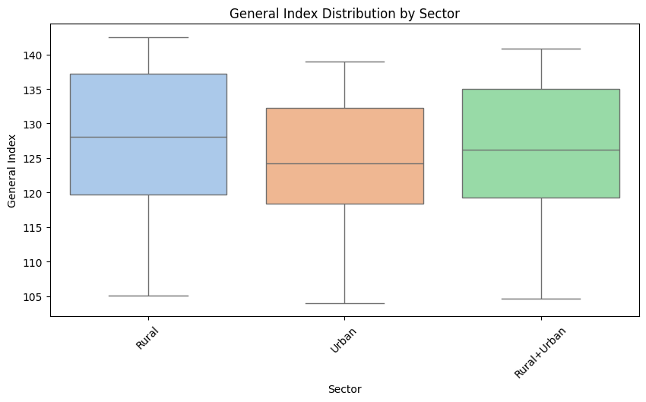
General Index Distribution by Sector

Slide 12
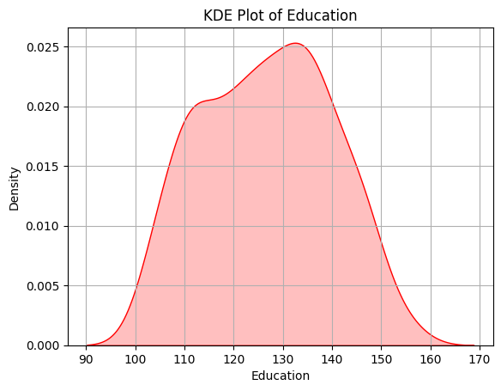
KDE Plot of Education

Slide 13
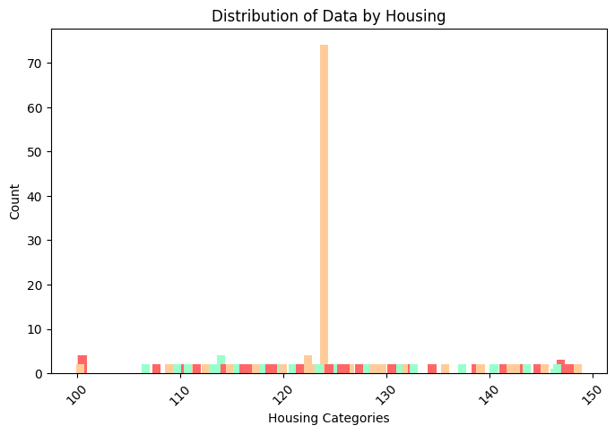
Distribution of Data by Housing

Slide 14
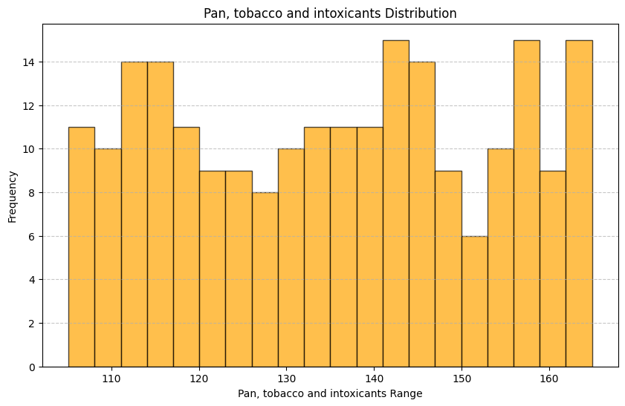
Pan, tobacco and intoxicants Distribution

Slide 15
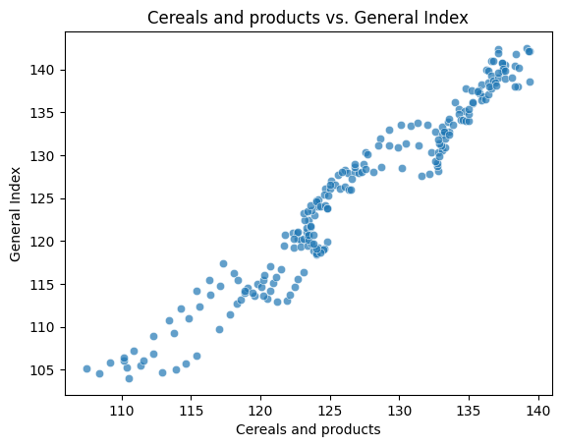
Cereals and products vs. General Index

Slide 16
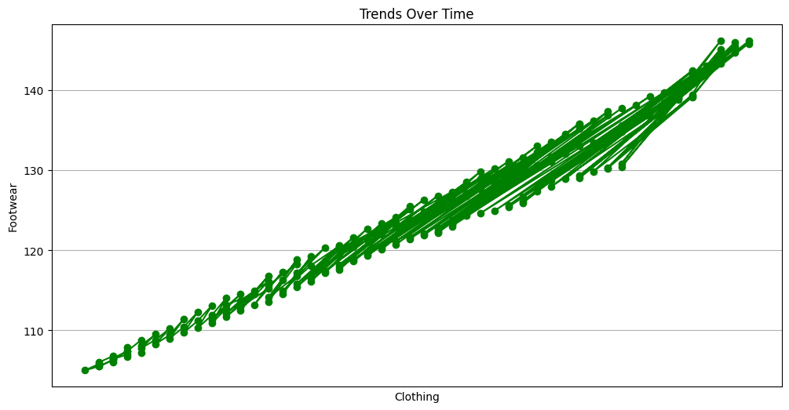
Trends Over Time

Slide 17
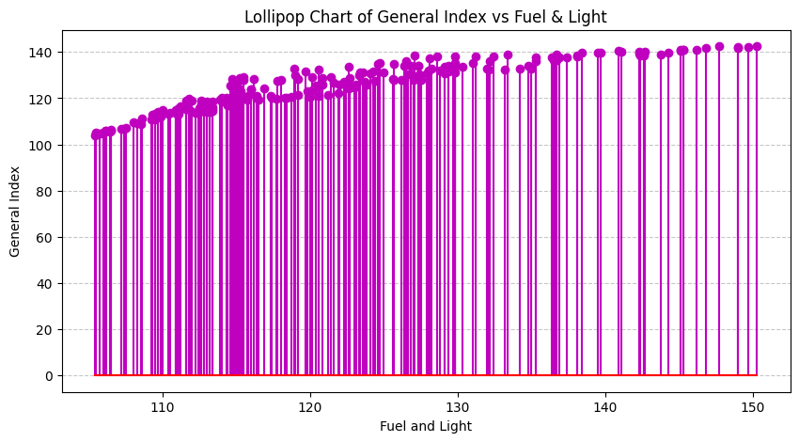
Lollipop Chart of General Index vs Fuel & Light

Slide 18
Conclusion on the Analysis of the Government Dataset (Consumer Price Index - CPI)
1. Dataset Overview:
The dataset consists of 222 rows and 30 columns.
It represents Consumer Price Index (CPI) data for various sectors: Rural, Urban, and Combined (Rural+Urban).
Covers multiple consumer expenditure categories, including food, non-food items, and a general price index.
Key Categories:
Covers a broad range of consumer price indices for food, clothing, fuel, housing, health, transport, and other miscellaneous goods/services. The General index column likely represents an overall index.
Data Cleaning & Processing:
Handling Missing Values: The Housing column had 74 missing values, which were replaced with the median value for consistency.
Date Standardization: Combined Year and Month into a single Date column for better time-series analysis.
Duplicate Removal: Ensured data integrity by eliminating duplicate rows.
4. Sector-Wise Breakdown:
Data is categorized into Rural, Urban, and Rural+Urban, enabling comparative analysis between different population segments.
5. Final Observations:
The cleaned dataset is structured, consistent, and ready for further statistical modeling and visualization.
This analysis can help in inflation tracking, economic policy-making, and understanding price trends across different consumer categories.

Slide 19
THANK YOU

